Slide 1

Elasticity of Demand of Supply
Copyright@ Ashis Kumar Pradhan

Slide 2
Concept of the Elasticity
Elasticity of demand measures how much the quantity demanded changes with a given change in price of the item (Price Elasticity), change in consumer’s income (Income Elasticity), or change in price of a related product (Cross Elasticity).
Price elasticity is a concept that also relates to supply.
◆ What are they? – Responsiveness measures
◆ Why introduce them? – Demand and supply responsiveness clearly matters for lots of market analyses.
◆ Why not just look at slope? – Want to compare across markets: inter market – Want to compare within markets: intra market – slope can be misleading – want a unit free measure

Slide 3
Why Economists Use Elasticity
An elasticity is a unit-free measure.
By comparing markets using elasticities it does not matter how we measure the price or the quantity in the two markets.
Elasticities allow economists to quantify the differences among markets without standardizing the units of measurement.

Slide 4
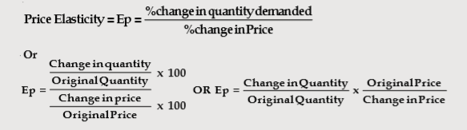

Elasticity
Measurement of the percentage change in one variable that results from a 1% change in another variable.
Elasticity of demand is the responsiveness of the quantity demanded of a good due to changes in one of the variables on which demand depends. Variants: Price elasticity, Income elasticity, Cross elasticity.

Slide 5
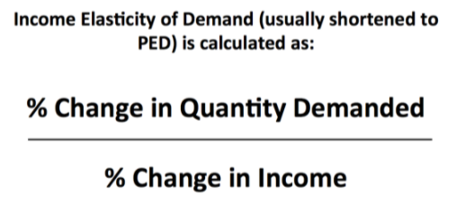
Income Elasticity
Income elasticity of demand denotes the responsiveness to change in consumers’ income with the change in the demand for a certain good.

Slide 6

Cross Elasticity
Cross elasticity of demand (XED) measures the percentage change in quantity demand for a good after a change in the price of another._x000b_
For example: if there is an increase in the price of tea by 10%. and the quantity demanded for coffee increases by 2%, then the cross elasticity of demand = 2/10 = +0.2
Substitute goods will have a positive cross-elasticity of demand.
Complements will have a negative cross elasticity of demand
Unrelated goods will have a cross-elasticity of demand of zero. The price of apples has no effect on demand for Apple computers.

Slide 7
Types: Price elasticity of demand and Price elasticity of Supply
Price elasticity of demand: how sensitive is the quantity demanded to a change in the price of the good.
Price elasticity of supply: how sensitive is the quantity supplied to a change in the price of the good.
Often referred to as “own” price elasticities.

Slide 8
Examples of Own Price Demand Elasticities
When the price of gasoline rises by 1% the quantity demanded falls by 0.2%, so gasoline demand is not very price sensitive.
– Price elasticity of demand is -0.2 .
When the price of gold jewelry rises by 1% the quantity demanded falls by 2.6%, so jewelry demand is very price sensitive.
– Price elasticity of demand is -2.6.

Slide 9
Examples of Own Price Supply Elasticities
When the price of DaVinci paintings increases by 1% the quantity supplied doesn’t change at all, so the quantity supplied of DaVinci paintings is completely insensitive to the price.
– Price elasticity of supply is 0.
When the price of meat increases by 1% the quantity supplied increases by 5%, so meat supply is very price sensitive.
– Price elasticity of supply is 5.

Slide 10
Examples of Unit-free Comparisons
Gasoline and jewellery – It doesn’t matter that gas is sold by the gallon for about $1.09 and gold is sold by the ounce for about $290.
We compare the demand elasticities of -0.2 (gas) and -2.6 (gold jewellery).
Gold jewellery demand is more price sensitive.

Slide 11
Examples of Unit-free Comparisons
Paintings and meat – It doesn’t matter that classical paintings are sold by the canvas for millions of dollars each while meat is sold by the pound for about $1.50.
We compare the supply elasticities of 0 (classical paintings) and 5 (meat).
Meat supply is more price sensitive.

Slide 12
Slope vs Elasticity
The slope measures the rate of change of one variable (P, say) in terms of another (X, say).
The elasticity measures the percentage change of one variable (X, say) in terms of another (P, say).

Slide 13
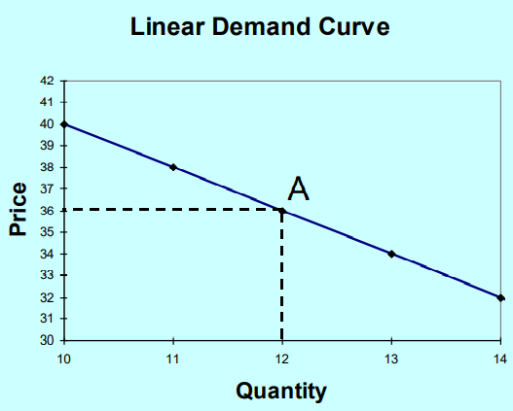
Slope vs Elasticity
Slope = (40 -32)/(10 -14)= - 2
1/slope = -1/2
P/X = 36/12 = 3 at point A
P/X x 1/slope = -1.5
Elasticity of demand = -1.5
Absolute value of the elasticity = 1.5

Slide 14
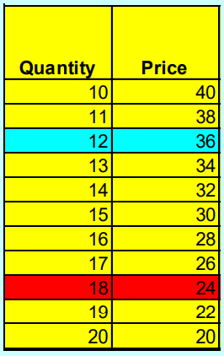
Exercise
Compute the elasticity at the point indicated in red on the table (X=18,P=24).

Slide 15
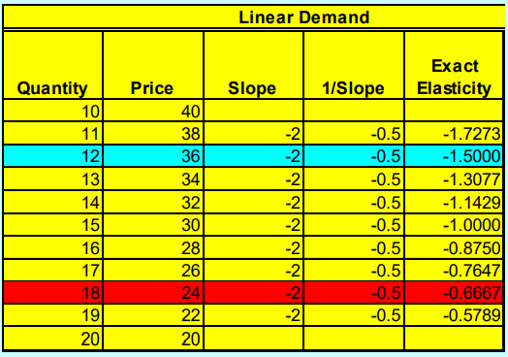
Elasticities and Linear Demand
The elasticity varies along a linear demand (or supply) curve. This is illustrated in the linear demand curve table above.
Note: Usually we would report last column as absolute value.

Slide 16
Supply Elasticities
The price elasticity of supply is always positive.
Economists refer to the price elasticity of supply by its actual value.
Exactly the same type of point and arc formulas are used to compute and estimate supply elasticities as for demand elasticities.

Slide 17
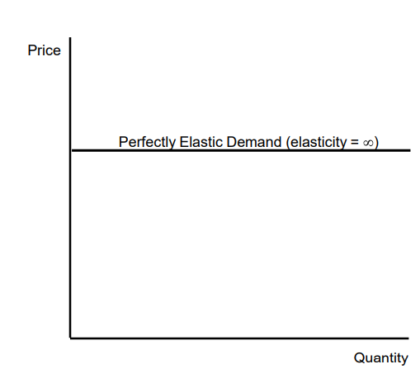
Perfectly Elastic Demand
We say that demand is perfectly elastic when a 1% change in the price would result in an infinite change in quantity demanded.

Slide 18
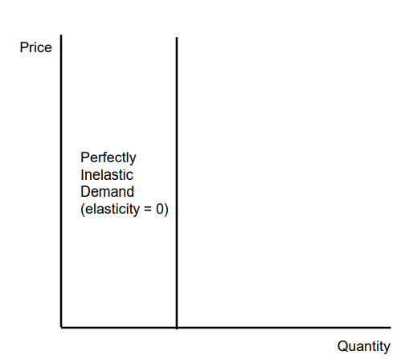
Perfectly Inelastic Demand
We say that demand is perfectly inelastic when a 1% change in the price would result in no change in quantity demanded.

Slide 19
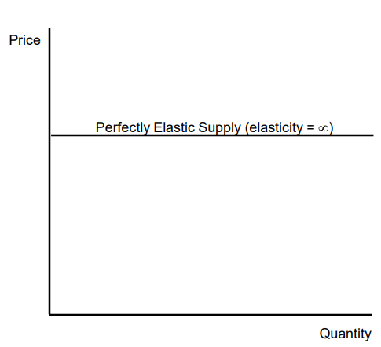
Perfectly Elastic Supply
We say that supply is perfectly elastic when a 1% change in the price would result in an infinite change in quantity supplied.

Slide 20
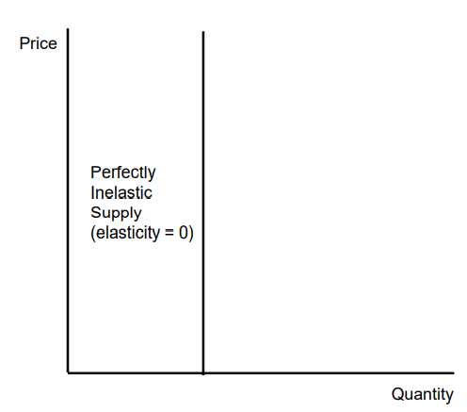
Perfectly Inelastic Supply
We say that supply is perfectly inelastic when a 1% change in the price would result in no change in quantity supplied.

Slide 21
Thanks

